Slide 2

Musician of the month
2024 - 2025

Slide 3
September
Stevie Wonder

Slide 4
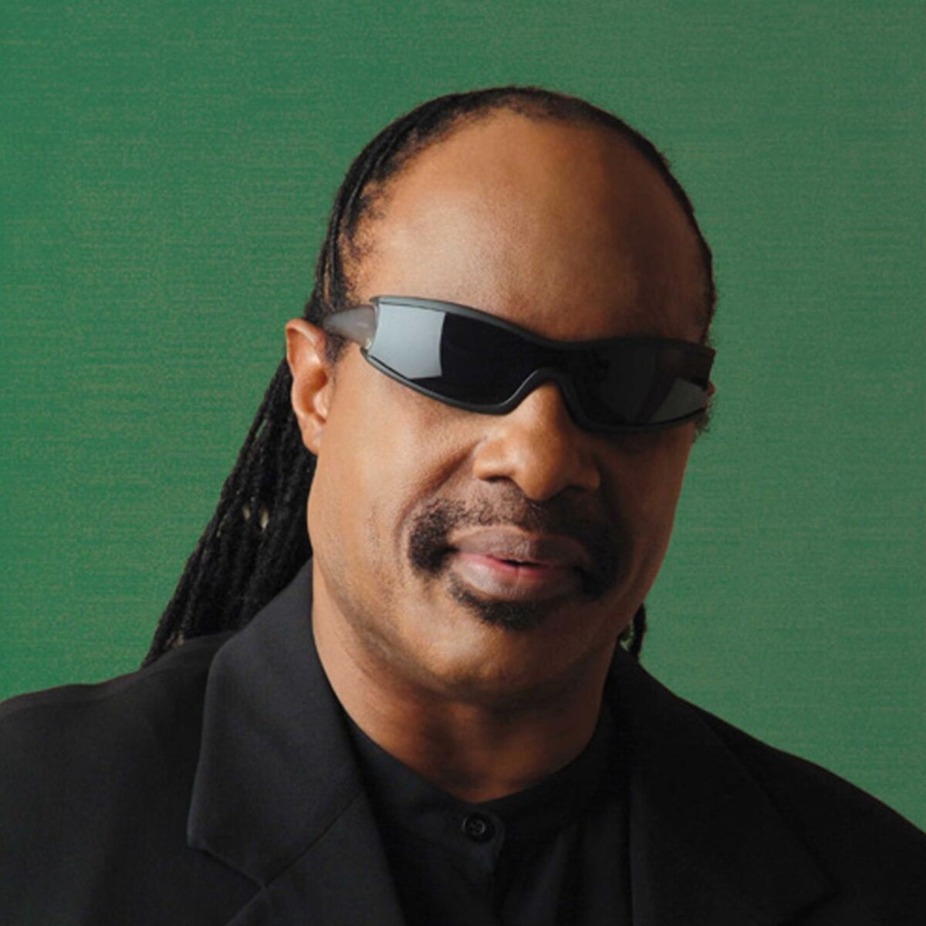

Stevie Wonder

Slide 5
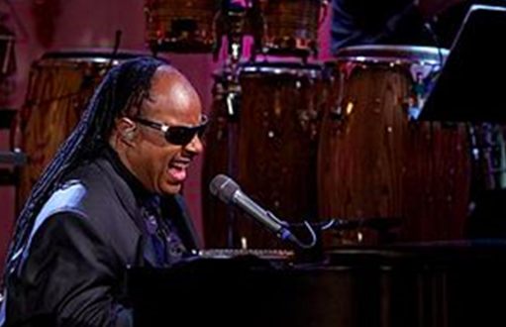
Stevie Wonder
Born Stevland Hardaway Morris, known professionally as Stevie Wonder, he is an American singer-songwriter, who is credited as a pioneer and has influenced musicians across a range of genres that include rhythm and blues, pop, soul, gospel, funk and jazz. A virtual one-man band, Wonder’s use of synthesizers and other electronic musical instruments during the 1970s was like no-one else before him. Wonder has gone on to become one of the best-selling music artists of all time.

Slide 6
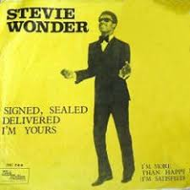
Stevie Wonder
•He was considered a child prodigy because he was a skilled musician (piano, organ, harmonica, drums) by 8 years old.
•He made his first recording debut at the age of 12.
•He was blind, but not born blind; he became blind due to receiving too much oxygen in an incubator when he was born prematurely.
•His first stage name was “Little Stevie Wonder.”
•He has received 25 Grammys and was inducted into the Rock and Roll Hall of Fame in 1989.
•He was a huge advocate for social issues and used his single, Happy Birthday, to help create a national holiday for Dr. Martin Luther King Jr’s birthday.
•Because of his commitment to social issues, he was named the United Nations Messenger of Peace in 2009.

Slide 7
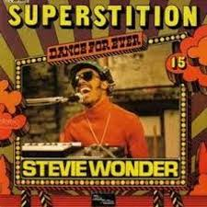

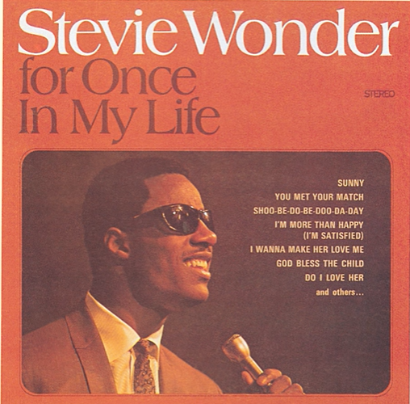
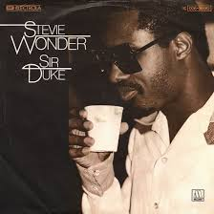
Stevie Wonder
Superstition
For Once in my Life
Sir Duke
Happy Birthday

