Slide 1
Ludwig van Beethoven
October – Musician of the Month

Slide 2
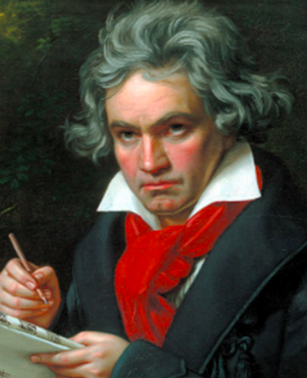
Ludwig van Beethoven (1770 – 1827)
Mozart belonged to the Classical period of music.
As orchestras had grown, this period was full
of dramatic and intense music!
Ludwig van Beethoven was born in Bonn, Germany.
As a boy, Ludwig became a traveling performer,
and soon, he was supporting his family.
In his early twenties, Beethoven moved to Vienna,
where he spent the rest of his life.
By 1800 his hearing started to deteriorate,
and by 1814, he was almost completely deaf.
He continued to compose and perform
despite not being able to hear.
He never married or had children.
Despite his beautiful music, Beethoven
was described to be lonely and miserable,
short tempered and greedy.

Slide 3
Ludwig van Beethoven (1770 – 1827)
By the time the ninth symphony was performed, Beethoven had lost his hearing completely. At the premiere, he had to be turned around to see the reaction of the audience as he could not hear either the applause or the orchestra perform the work.

Slide 4

Ludwig van Beethoven (1770 – 1827)

Slide 5


Moonlight Sonata
Symphony No 9
Fur Elise
Ode to Joy

