Slide 1
Fisherman’s Friends

Slide 2
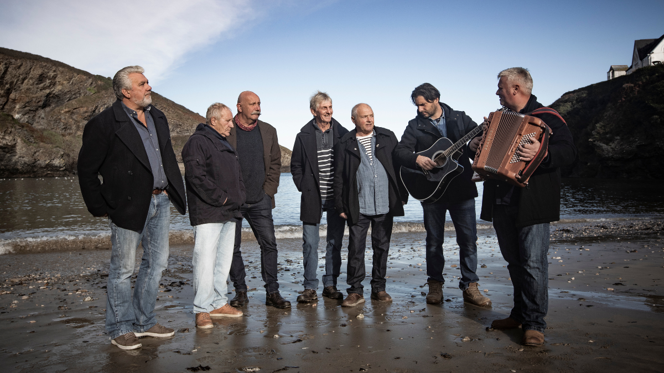
Group formed in Cornwall in 1990.
All sections of the vocal range
were covered.
They sing sea shanties and songs
of the sea.
Began by performing at charity events
and locally.
In 2009 they were spotted and the
rest is history!
Films have been made about their
Success and they have been on many
nationwide tours.

Slide 3
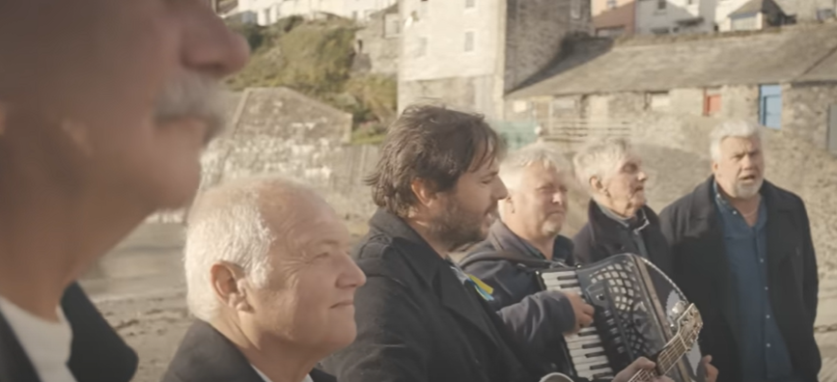
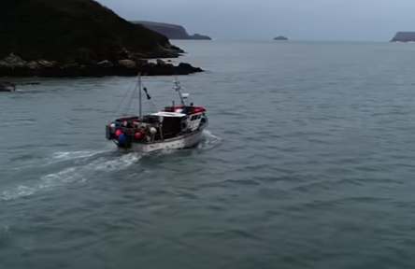
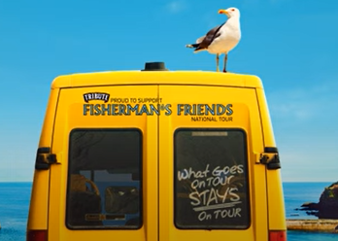
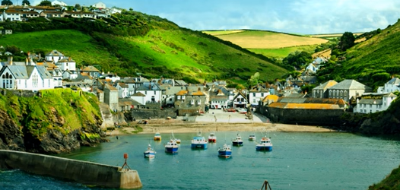
Find out more:
https://thefishermansfriends.com/
Video Clips:
Click on the picture to link to the video
Cornwall my Home
Keep Hauling
Wellerman
Sloop John B (Live @ Cambridge Folk Festival)

