Slide 1
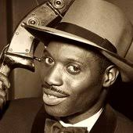
Lord kitchener
January’s musician of the month

Slide 2
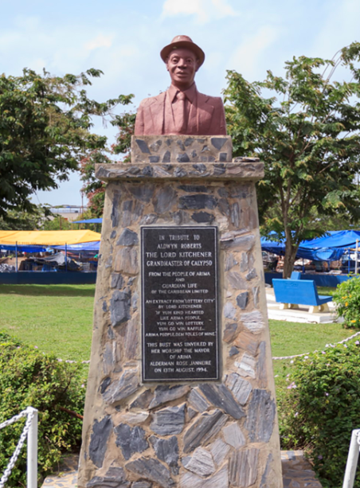
Lord Kitchener
Born in Trinidad in 1922, he moved to London in 1948.
As a child, he suffered from a severe speech impediment - but when he sang it was not at all detectable!
There is a statue of him entitled 'The Grandmaster of Calypso' in his native Trinidad.

Slide 3
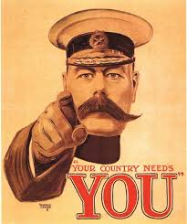
Aldwyn Roberts was his birth name.
He was the youngest of six children.
He was resilient and determined and overcame adversity to become a singer and musician. In 1938 he gave up following in his father’s footsteps of becoming a blacksmith and started singing in carnivals.
In 1944 he performed in the capital and changed his name to
Lord Kitchener as this man inspired him.
He came to UK in 1948 onboard Empire Windrush. He was filmed as he arrived from the Caribbean singing ‘London is the Place for Me’.

Slide 4
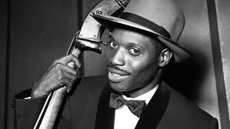
When he arrived in England he faced lots of racism.
In 1953 he married an English woman.
In 1962 he returned to Trinidad as a hero.
In 2000 he died in Trinidad aged 78.

Slide 5
Calypso is a blend of South American and African music.
It was used as a way of speaking about what was happening in the country at the time.
His first calypso piece was played on steel pans.

Slide 6
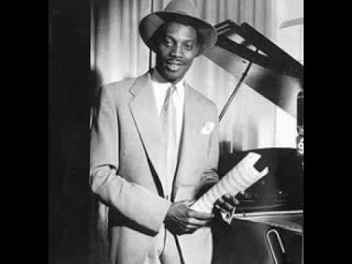
London is the Place for Me
Listen carefully to the lyrics. What do the lyrics tell you about his life in London?
How does the song make you feel?
Have you heard this song before?
Does it sound like any other songs you have heard before?

Slide 7
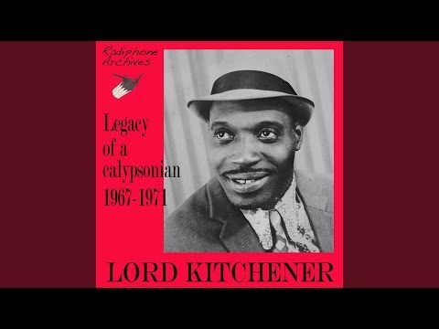
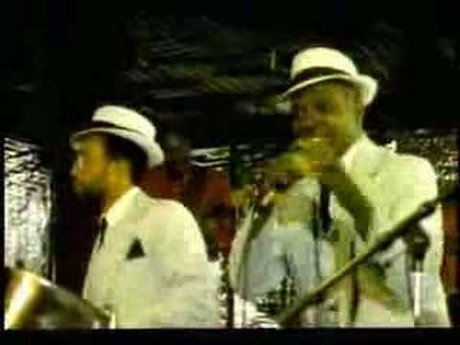
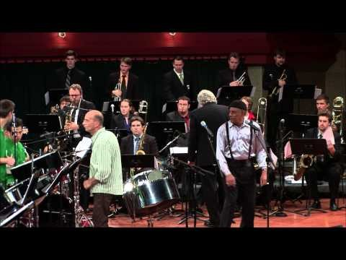
Pan in
A Minor
Rock n Roll
Calypso
Nora
Cricket
Champions

