Slide 1
Sir Elton John
February’s Musician of the Month

Slide 2
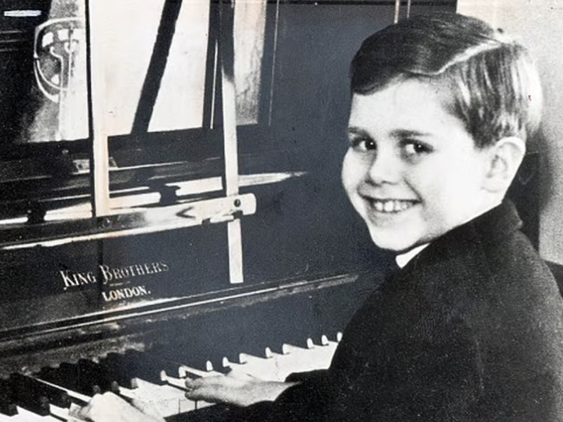
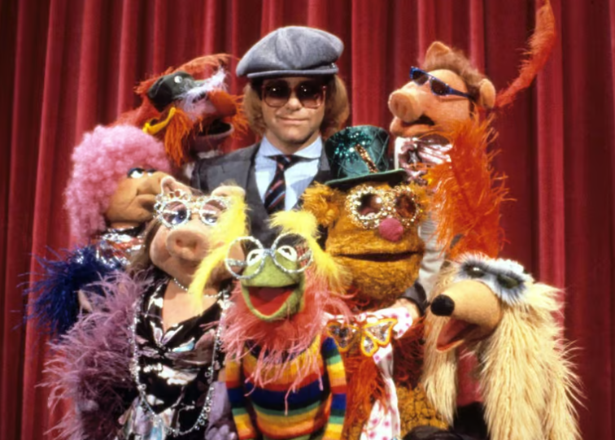
Sir Elton John
English singer, pianist and composer.
Born in London on 25th March1947.
His birth name was Reginald Dwight.
He played his grandmother’s piano as a young boy, playing “by ear” melodies that he heard on the radio.
Age 11, he won a scholarship to the Royal Academy of Music.

Slide 3
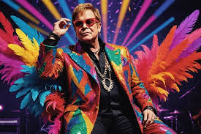
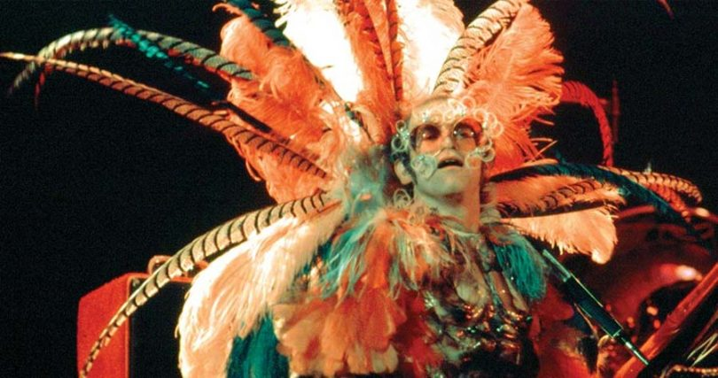
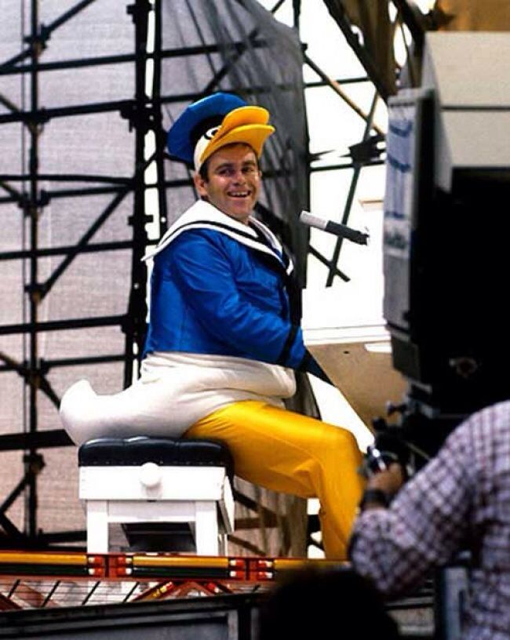
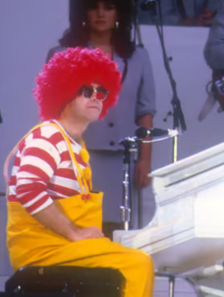
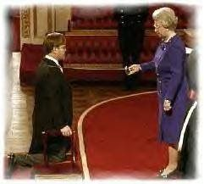
Sir Elton John
Elton is famous for his flamboyant costumes and energetic performances.
He composed music for The Lion King and Billy Elliot the Musical.
He was knighted by Queen Elizabeth II for services to music and charitable services in 1998.

Slide 4


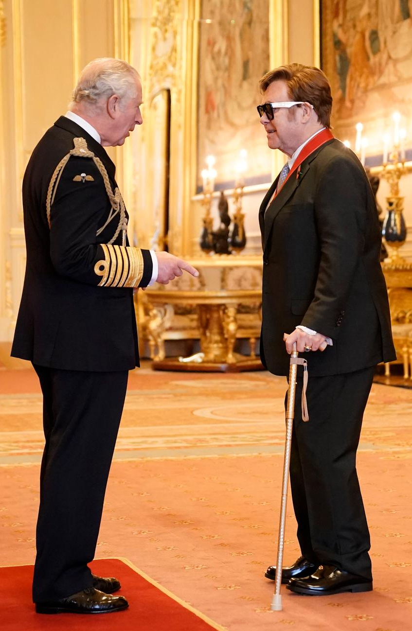
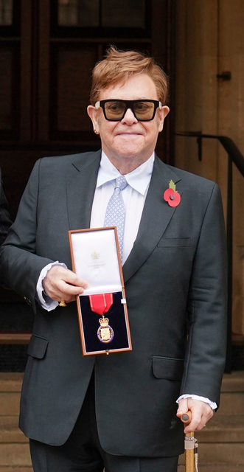
Sir Elton John
Elton and his husband David have adopted 2 boys, Zachary and Elijah.
In 2021, he was named a member of the Order of Companions of Honour, the highest honor given by the British Royal Family.
He has sold over 300 million records and has a net worth of over £450 million.

Slide 5
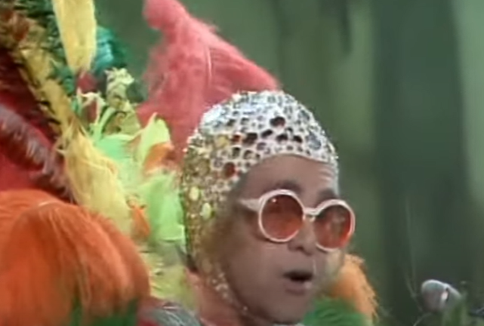

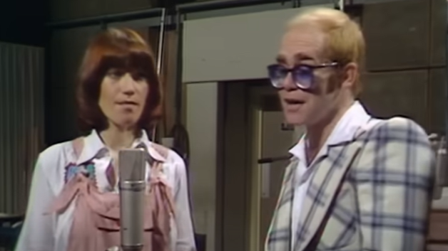


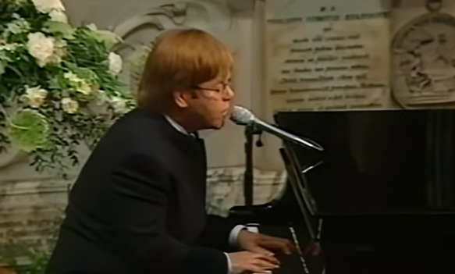
Sir Elton John

