Slide 1
Anna Clyne - composer
March 2025

Slide 2
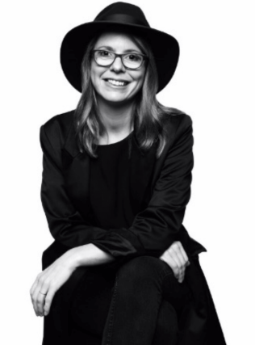

Anna Clyne
Anna is a British composer who was born in London in 1980.
A composer is a person who makes music.
She is a Grammy nominated composer of electro-acoustic music.
She has been described as a composer of ‘uncommon gifts and unusual methods.
She began writing as a child and completed her first composition at the age of 11.
She now lives in New York with her husband and dog.

Slide 3
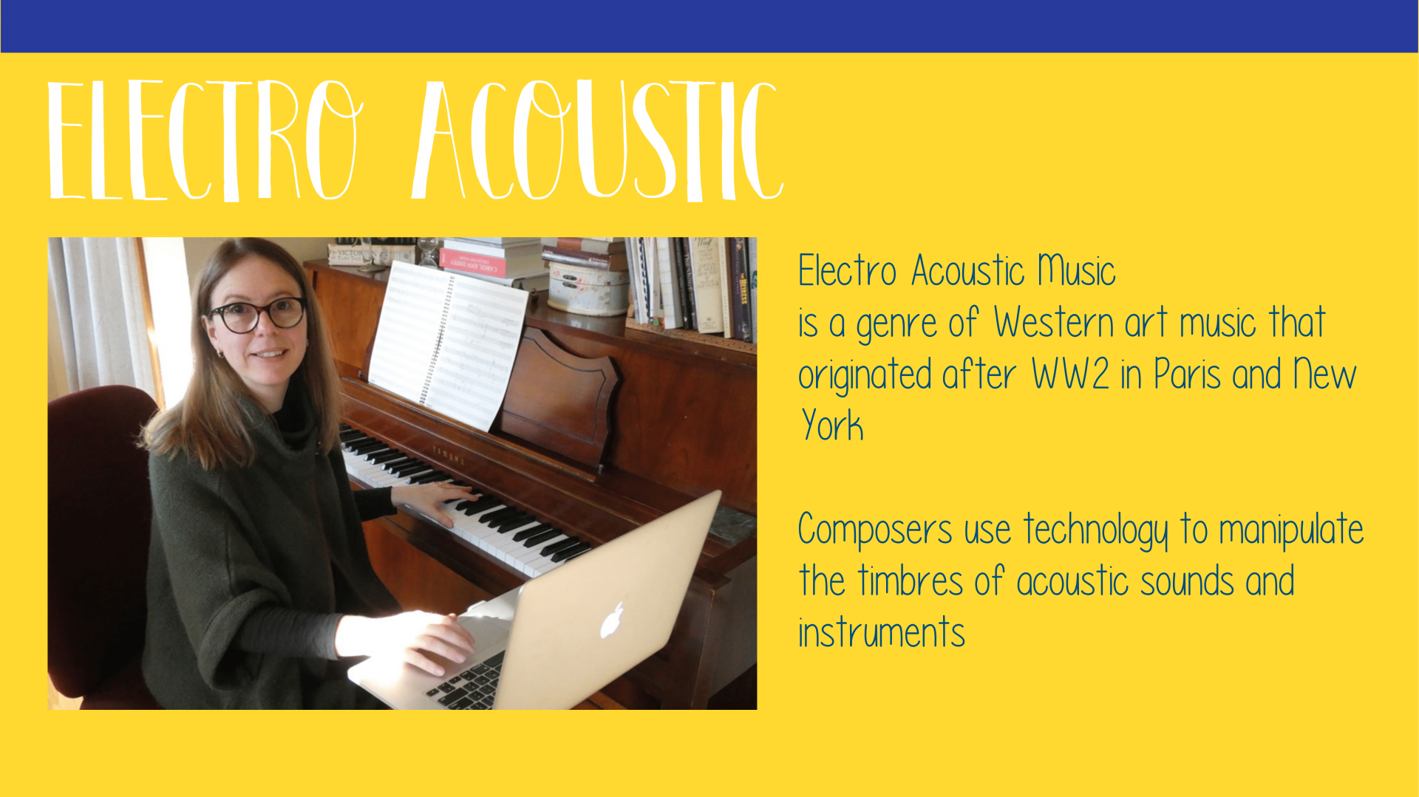

Slide 4
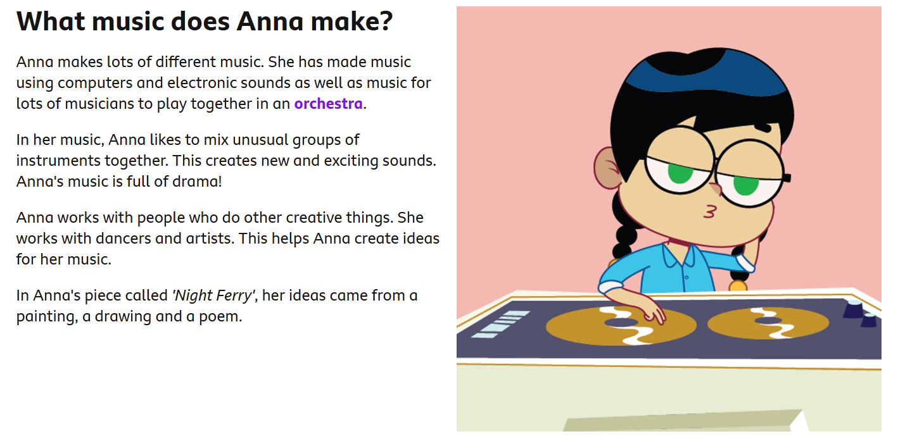

Slide 5


Slide 6
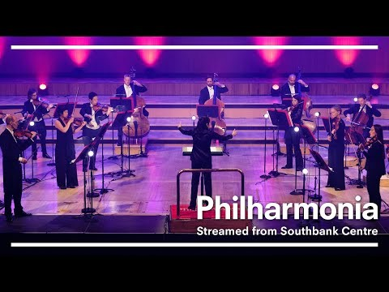
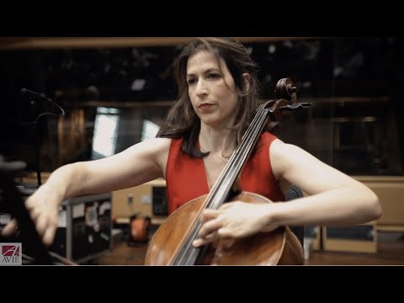
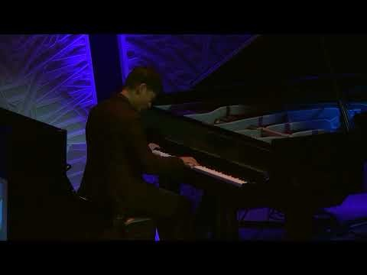
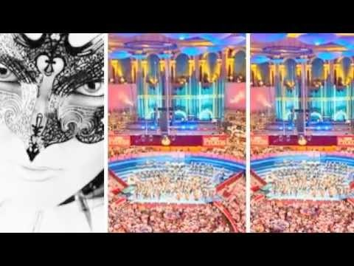
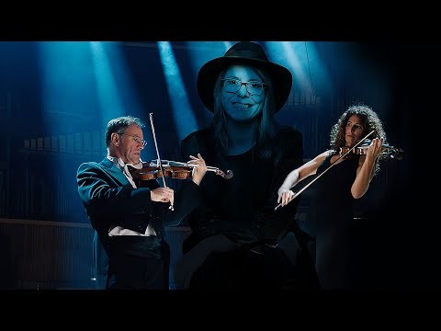
Have a listen to some of her compositions:

