Slide 1
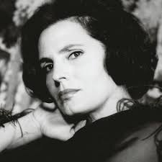
Amália Rodrigues
23rd July 1920 – 6th October 1999
April’s Musician of the Month

Slide 2
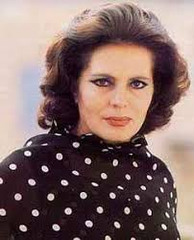

Amália Rodrigues
Amália Rodrigues was a Portuguese singer and actress.
She is known as the ‘Queen of Fado’.
Her soulful and expressive voice made her a beloved figure in fado music, a genre deeply rooted in Portuguese culture.

Slide 3
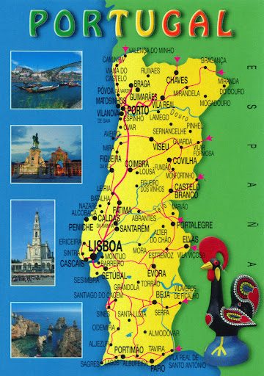
Amália was one of ten children and grew up in a poor neighbourhood in Lisbon.
She had to work hard as a child, selling fruit and working in a sweet factory.
Despite her difficult beginnings, she had a natural talent for singing and eventually became a superstar.

Slide 4
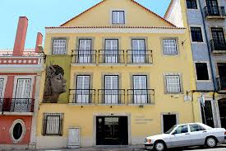
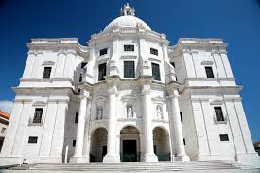
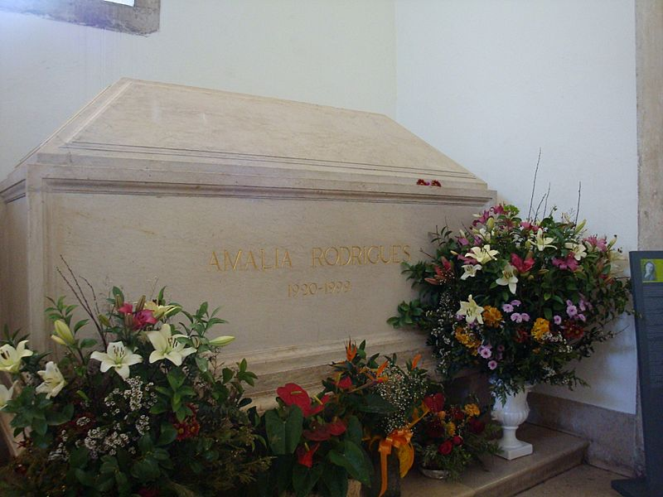
On 6 October 1999, Rodrigues died at age 79, in her Lisbon home. The Portuguese government declared three days of national mourning.
Her house, in Rua de São Bento, is now a museum.
She was given a state funeral, attended by tens of thousands.
She is interred at the National Pantheon alongside other Portuguese notables. She was the first woman ever to be allowed to be laidto rest among some of the greatest Portuguese figures.

Slide 5
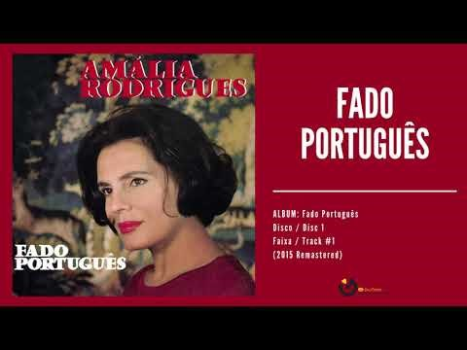


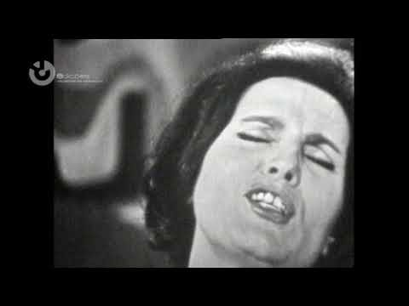
Amália Rodrigues

Slide 6

Fado
Fado is a unique kind of Portuguese music that often sounds a bit sad and melancholic, like a song about longing and loss.
It's sung with a deep, soulful voice and accompanied by a special Portuguese guitar called a ‘guitárra portuguesa’.

