Slide 1
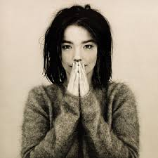
Björk
21st November 1965 -
Musician of the Month - May

Slide 2
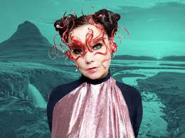
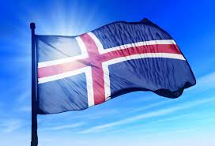
Björk
Björk is an Icelandic singer, songwriter, and producer known for her unique and experimental music style, distinctive vocals, and avant-garde approach to blending electronic, pop, and alternative genres.

Slide 3
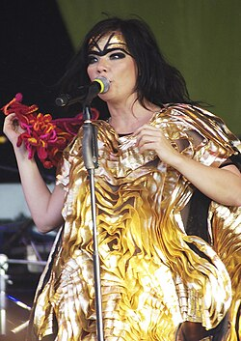
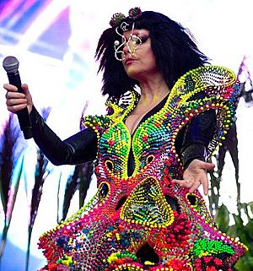
At the age of 6, Björk went to a music school where she studied classical piano and flute.
Aged 10, she performed in a school concert and her vocal performance led to a recording contract.
Her debut album was recorded when she was just 11 years old.
Björk has an impressive 3-octave vocal range.
She has performed in many punk and alternative music bands throughout her career in music.
In 1993 she moved to London to pursue a solo career but now lives in Spain.
She is an environmental activist who uses music as her platform to raise awareness. She has said that Sir David Attenborough is one of her greatest musical influences.
Björk is famous not only for her music but for her unique fashion sense too.

Slide 4

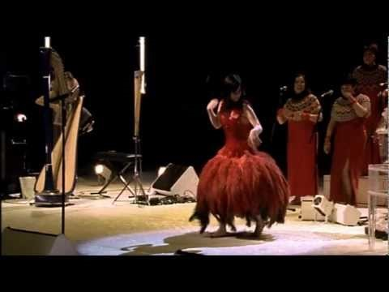
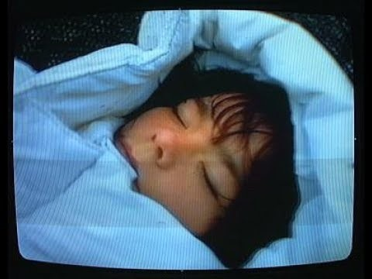
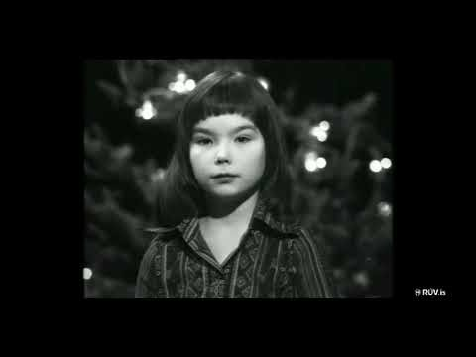
Bjork aged 11 on Icelandic TV reading the nativity.

