Slide 1
ABBA
Musician of the month - june

Slide 2
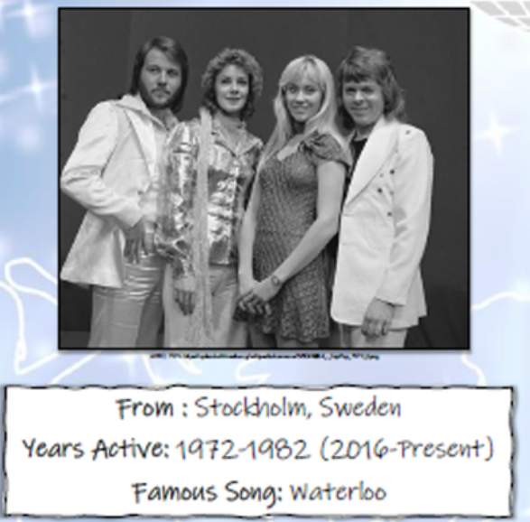
Agnetha
Benny
Bjorn
Anni-Frid

Slide 3

1974 Eurovision Song Contest winners
Sweden
Waterloo

