Slide 1
Ladysmith black mambazo
Musician of the Month - July

Slide 2
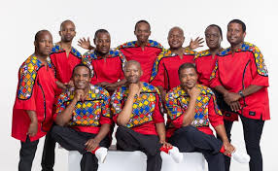

Ladysmith Black Mambazo are a South African a cappella group. They are known for their distinctive isicathamiya singing style and have received global recognition, including multiple Grammy Awards. They recently celebrated their 65th anniversary in music.

Slide 3
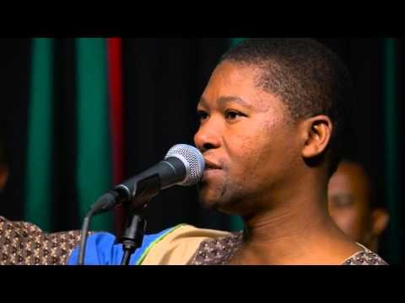

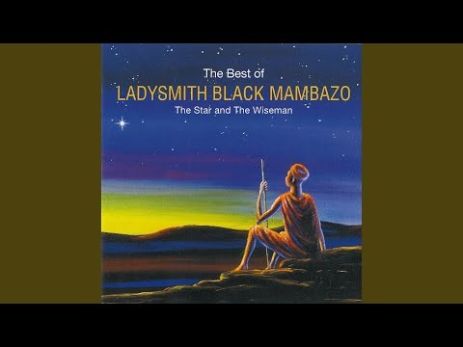
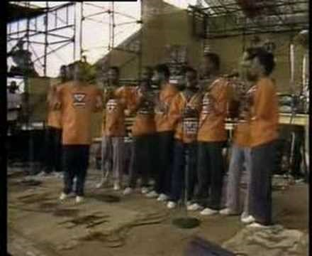
A selection of their music:

